Slide 1
LA Cities Home Buyer Guide
USC DataBootcamp First Project
Group : PyitUp

Slide 2
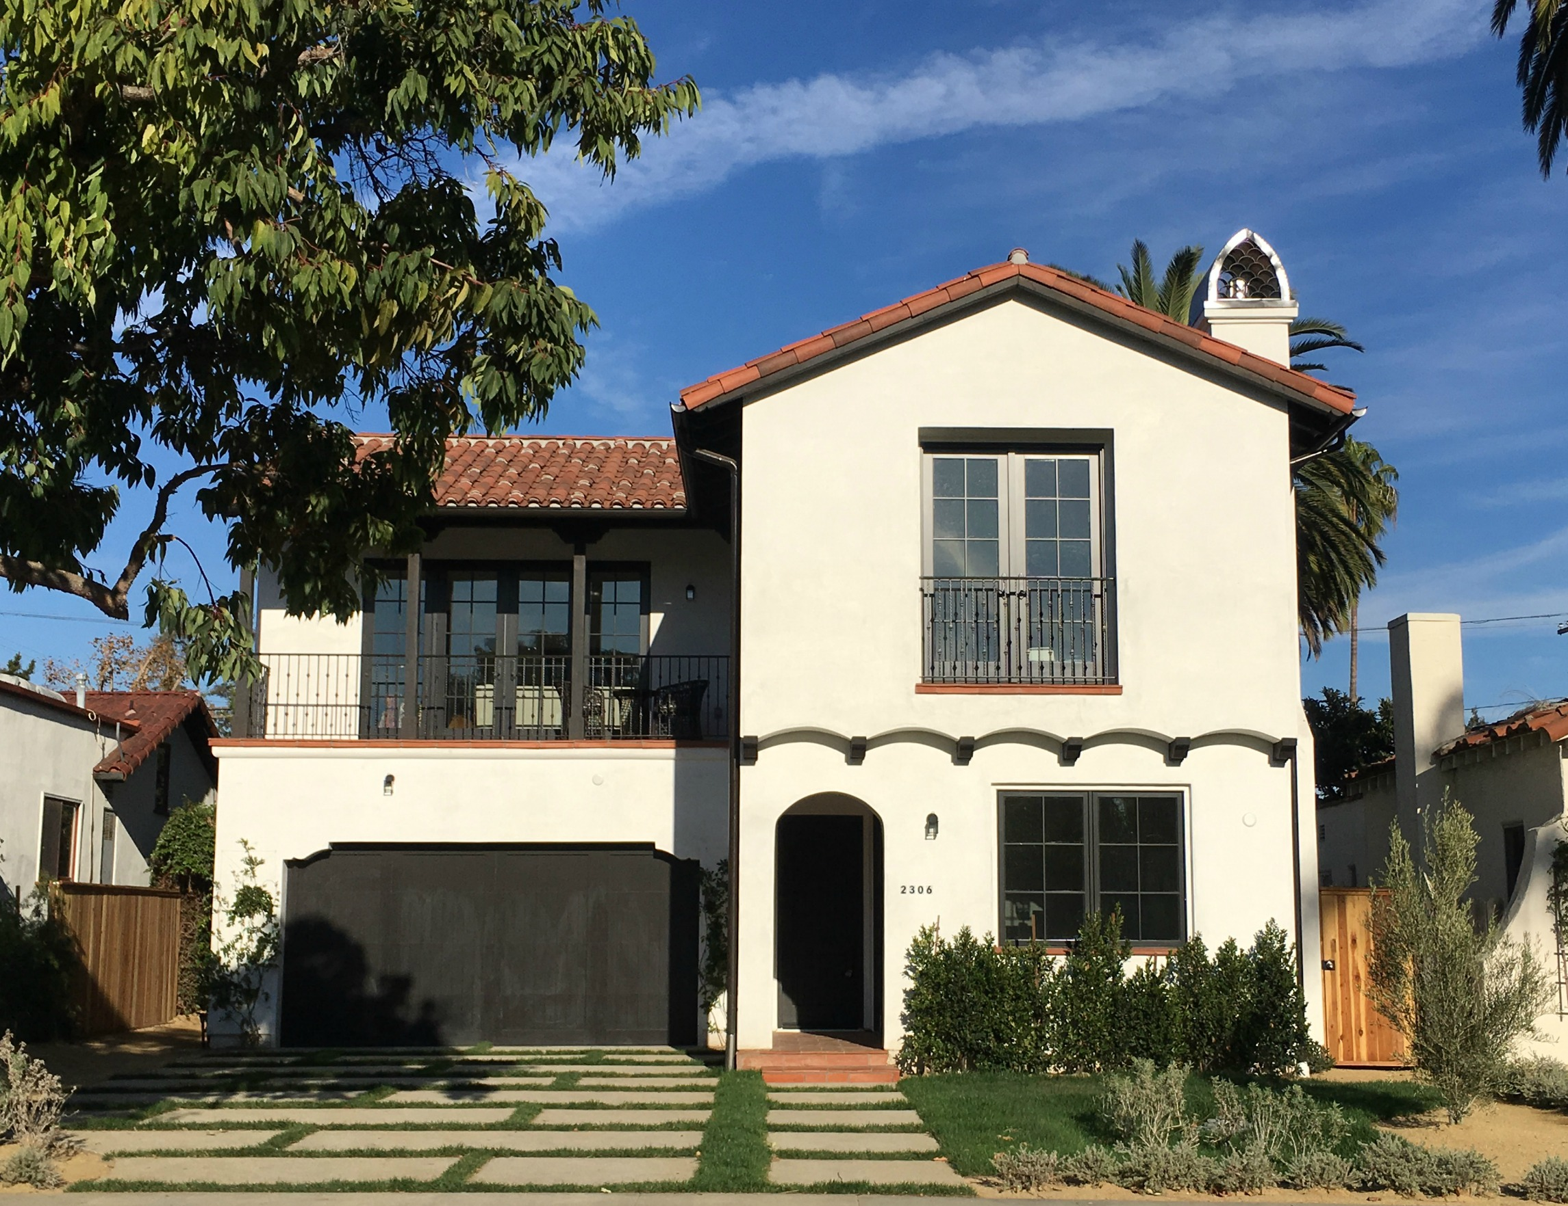
Agenda
Purpose of the Project
Identify the Data Source
Strategy and Metrics
Data Collection
Data Visualization /Analysis (clean up
Recommendation
Limitations
Q&A

Slide 3
Purpose of the Project
Purpose:
Building a simple home guide to home buyers on multiple factors associated with house prices in order to make the buyers more informed when they are making buying decisions
Scope:
Buyer profile: first time buyer, school focus buyer (for kids), professional buyer, rich buyer,
Region: LA County
Time: Most Recent data (“less than a year”)

Slide 4
Identify the Data Source
Database/Sources:
Census data: API Census 2016: https://github.com/CommerceDataService/census-wrapper
Google Data: Google API Search: https://developers.google.com/places/
Zillow API (Prices per properties): https://www.zillow.com/webservice/GetSearchResults.htm?
School Ranking Data: Build manually from: http://school-ratings.com/counties/Los_Angeles.html
Crime data https://catalog.data.gov/dataset/crime-data-from-2010-to-present (from: data.lacity.org)

Slide 5
Strategy and Metrics
Strategy:
- Chose only the 10 cities in Los Angeles County with a substantial population for this project.
Look at various metrics (House prices, population, school ranks, HH income, etc) and compare between cities

Slide 6

Data Collection (ZILLOW)
Zillow API requires specific addresses so we used a reverse geocode function to turn coordinates into addresses
After getting addresses, we called the Zillow API to check if a property exists at each address
For valid properties we ran Zillow’s GetDeepSearchResults function to get further information, such as Zestimate, square ft, # of bedrooms and bathrooms, etc.
Did necessary data cleaning and wrote information to CSV

Slide 7
DATA COLLECTION
API Google Search
API Census
Purpose: Get amenities close to selected cities
Challenge: Choose the right “target_type”
Ex. Public transportation: ["light_rail_station","transit_station","subway_station"]
Purpose: Get rates could influence in a buyer for choosing a place to buy a property.
Challenges:
Timeout: Call API several times.
Clean data:
median_age_value = los_angeles_census_df["Median Age"]>-666666666
median_male_age_value = los_angeles_census_df["Median_male_age"]>-666666666
median_female_age_value = los_angeles_census_df["Median_female_age"]>-666666666
age_stats_df = los_angeles_census_df[median_age_value & median_male_age_value & median_female_age_value]
Remove invalid data
New Dataframe with clean data

Slide 8
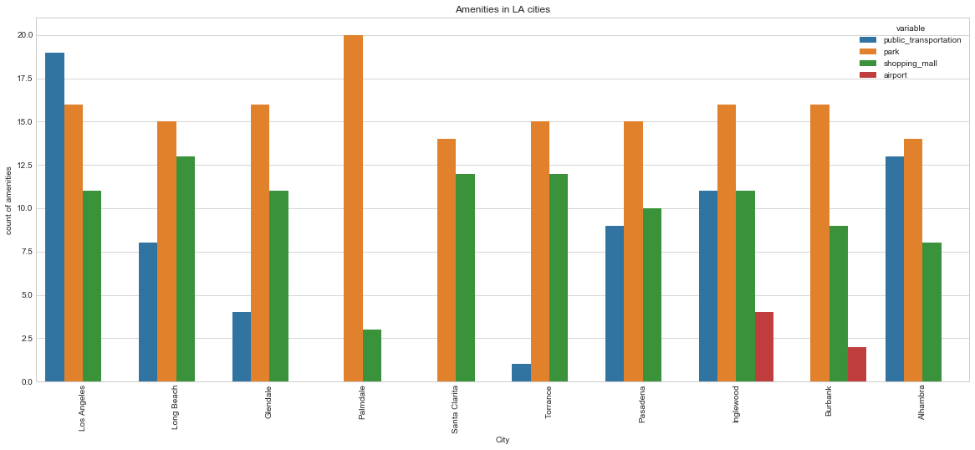
Data Visualization /Analysis Google Api

Slide 9
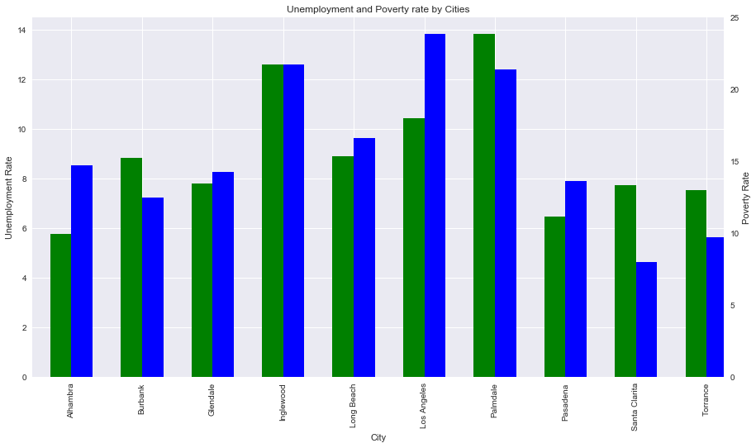
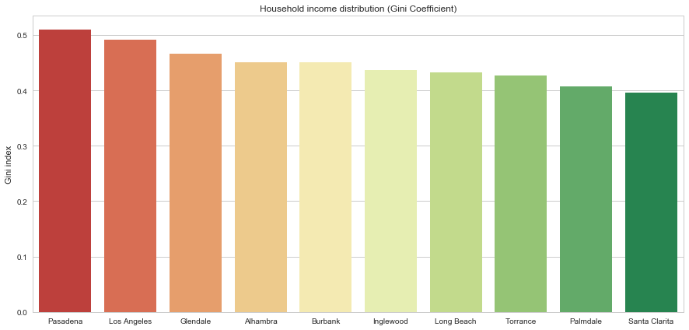
Census API
Gini index: Help to understand household income distribution.
Best value 0… going to green
Worst value 1… going to red
Analysis of two rates in one graph, different metrics in axes left (Unemployment rate) and right (Poverty rate)

Slide 10
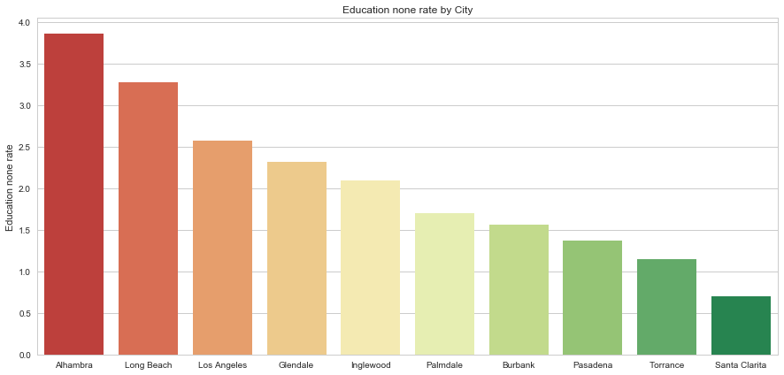
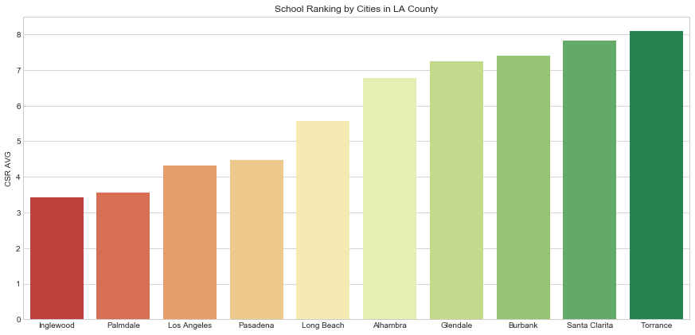
Census API
Rate of persons age 25 and over who completed no schooling
Best value… going to zero (green)
CSR average includes: Elementary, middle and high school.
Best value: 10 (green)

Slide 11
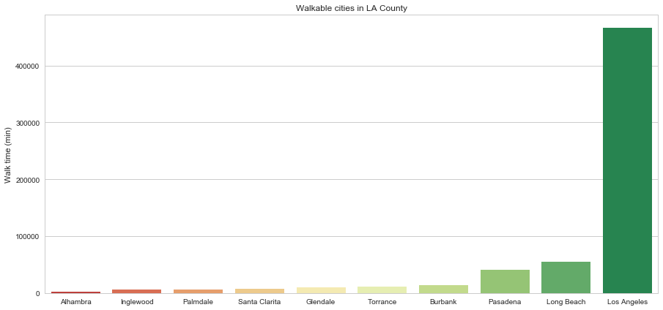
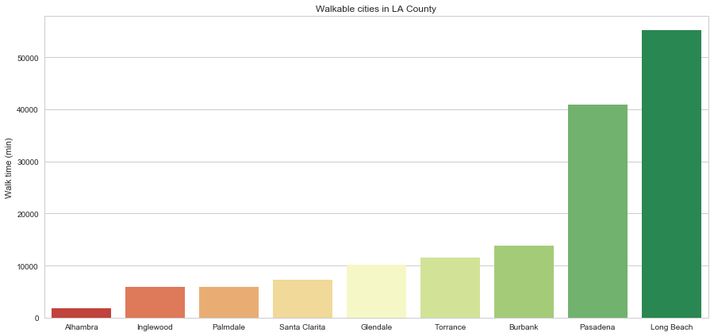
Census API
Walkable rate: Time spent commuting (in minutes): walking
LA has a considerable higher rate due to Downtown
Analysis without LA

Slide 12
Recommendation
First Time Buyer: Torrance / Los Angeles
Reasonable House Price / Convenient Amenities
Rich Buyer: Pasadena / Glendale / Burbank
House Price / Airport / Household Income Distribution
School Focus Buyer: Torrance / Santa Clarita / Burbank / Glendale / Alhambra
Good School Ranking
Professional Buyer: Los Angeles / Long Beach / Inglewood / Pasadena
Convenient / Career Potential / Higher Average Income / Transportation
Investment Buyer: Pasadena / Burbank / Alhambra / Glendale
Rent Price / House Price Growth Rate

Slide 13

Limitations
Zillow API requiring an exact address to call the API was a bit troublesome, so we had to figure out some method to generate addresses within a given radius, but it’s imprecise
Some properties had multiple Zestimate (estimate of property’s worth) if it had been sold multiple times, it was difficult to pick the most recent one
Zillow API made it confusing to check whether or not the house is still currently on the market, we went by whether or not it had a Zestimate
Zillow only allows 1000 API calls per day per key, not good for testing loops

Slide 14
Limitations
Not all the attribute was used to help with the recommendation (i.e. Crime Rate)
Limited Sample Data (i.e. 50ish Zillow data per city)

Slide 15
Q&A

